Slide 1
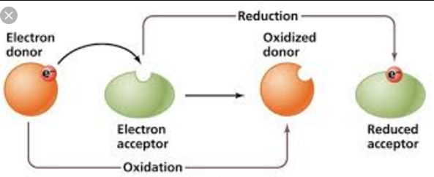
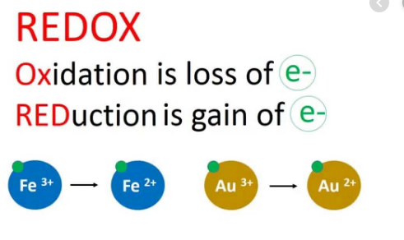
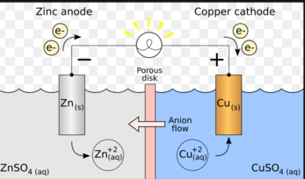
Redox Reactions
CHM 101

Slide 2

Redox Reactions
Historically, the term "oxidation" was used because the redox reactions that were first systematically investigated took place in oxygen, with oxygen being reduced and the other species being oxidized, hence the term oxidation reaction.
However, it was later realized that this case (oxidation reactions involving oxygen) was just one possible scenario. For example consider the redox reaction shown below.

Slide 3
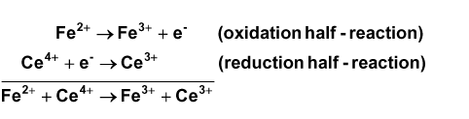
In this process the Fe²⁺ ion is oxidized, but there is no oxygen involved in this reaction.
The Ce⁴⁺ ion, which is reduced acts as the oxidizing agent. So oxidation reactions need not involve oxygen.
This redox reaction is actually the sum of two separate half-reactions (a reduction half-reaction and an oxidation half-reaction).

Slide 4
Redox Reactions
Redox reactions are reactions in which one species is reduced and another is oxidized. Therefore the oxidation state of the species involved must change. These reactions are important for a number of applications, including energy storage devices (batteries), photographic processing, and energy production and utilization in living systems including humans.
Reduction: A process in which an atom gains an electron and therefore decreases (or reduces its oxidation number). Basically the positive character of the species is reduced.
Oxidation: A process in which an atom loses an electron and therefore increases its oxidation number. In other words, the positive character of the species is increased.

Slide 5
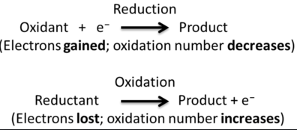
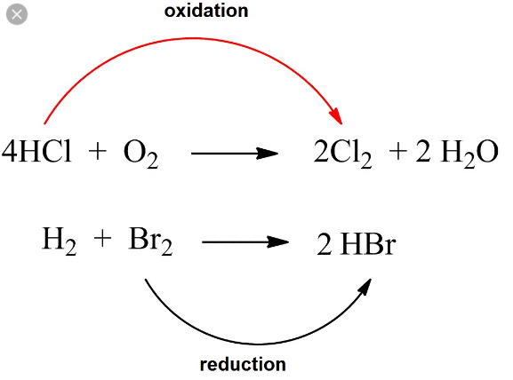

Slide 6
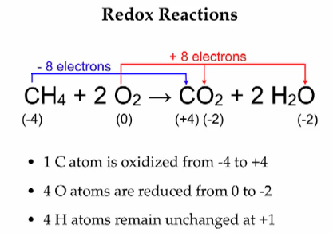

Slide 7
Oxidizing and Reducing Agents
An oxidizing agent, or oxidant, gains electrons and is reduced in a chemical reaction. Also known as the electron acceptor, the oxidizing agent is normally in one of its higher possible oxidation states because it will gain electrons and be reduced. Examples of oxidizing agents include halogens, potassium nitrate, and nitric acid.
A reducing agent, or reductant, loses electrons and is oxidized in a chemical reaction. A reducing agent is typically in one of its lower possible oxidation states, and is known as the electron donor. A reducing agent is oxidized, because it loses electrons in the redox reaction.
Examples of reducing agents include the earth metals, formic acid, and sulfite compounds.

Slide 8
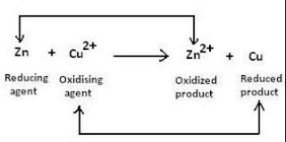
The key idea is the net movement of electrons from one reactant to the other:
Oxidation is the loss of electrons
Reduction is the gain of electrons
Oxidizing agent is the species doing the oxidizing
Reducing agent is the species doing the reducing

Slide 9
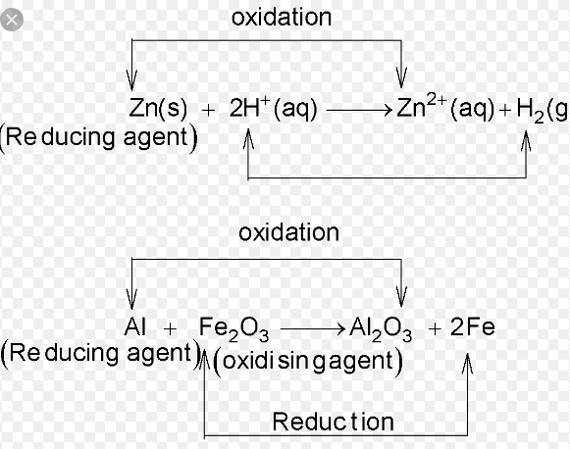
Oxidizing and Reducing Agents

Slide 10
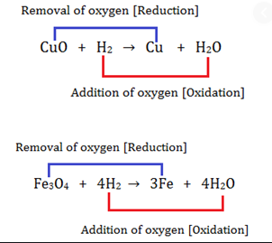
Oxidizing and Reducing Agents

Slide 11
Oxidizing and Reducing Agents

Slide 12
Oxidation State and Oxidation Number
Oxidation State: The condition of a species with a specified oxidation number. An element with a given oxidation number exists in the corresponding oxidation state.
Assigning Oxidation Numbers
The following rules for assignment of oxidation numbers are listed in hierarchical order.
Pure elements (in their natural, standard state): ox. # = 0.
Monatomic ions: ox. # = ionic charge.
F is always F (-I) in compounds.
Alkali metals (those in the 1st column of the periodic table): ox. # = I.
Alkaline-earth metals (those in the 2nd column of the periodic table): ox # = II.
Hydrogen is almost always H (I). The exception is in metal hydrides (MH_{x}).
Oxygen is almost always O (-II) in compounds. Exceptions are O-O and O-F.
The sum of all oxidation numbers in the species will equal the total charge of that species.

Slide 13
Oxidation Number
Oxidation number (O.N.) is also known as oxidation state.
It is defined as the charge the atom would have if electrons were not shared but were transferred completely
For a binary ionic compound, the O.N. is equivalent to the ionic charge
For covalent compounds or polyatomic ions, the O.N. is less obvious and can be determined by a given set of rules

Slide 14
Rules for Assigning an Oxidation Number
General Rules
1. For an atom in its elemental form (Na, O2 ): O.N. = 0
2. For a monatomic ion: O.N. = ion charge
3. The sum of O.N. values for the atoms in a molecule or formula unit of a compound equals to zero. (equals to the ion’s charge if it is a polyatomic ion)

Slide 15
Rules for Specific Atoms or Periodic Table Groups
1. For Group 1A(1): O.N. = +1 in all compounds
2. For Group 2A(2): O.N. = +2 in all compounds
3. For hydrogen: O.N. = +1 in combination with nonmetals O.N. = -1 in combination with metals and boron
4. For fluorine: O.N. = -1 in all compounds
5. For oxygen: O.N. = -1 in peroxides O.N. = -2 in all other compounds (except with F)
6. For Group 7A(17): O.N. = -1 in combination with metals, nonmetals (except O), and other halogens lower in the group

Slide 16
Balancing Redox Equations
When balancing redox reactions, make sure that the number of electrons lost by the reducing agent equals the number of electrons gained by the oxidizing agent •
Two methods can be used:
Oxidation number method
Half-reaction method

Slide 17
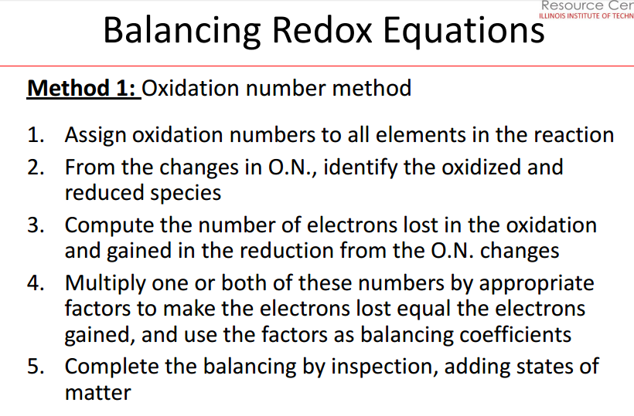

Slide 18
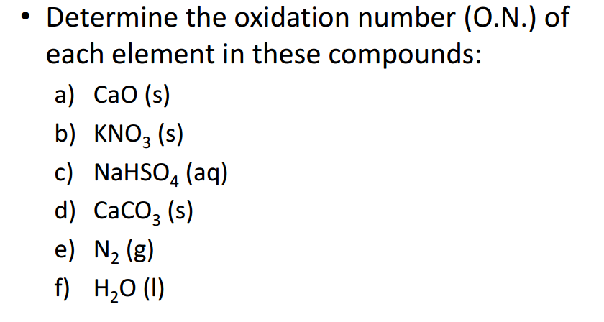
Example 1

Slide 19
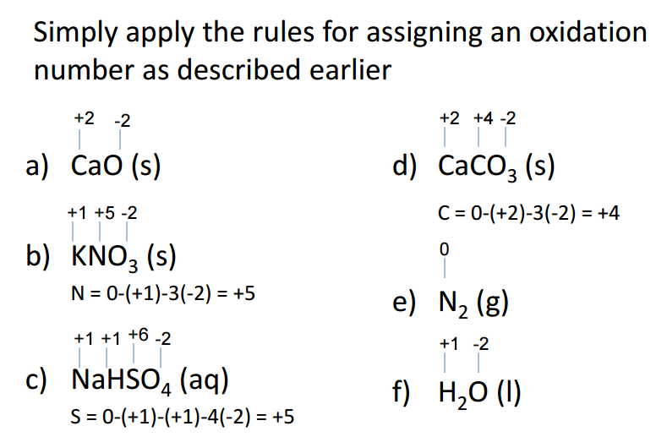
Solution to Example 1

Slide 20
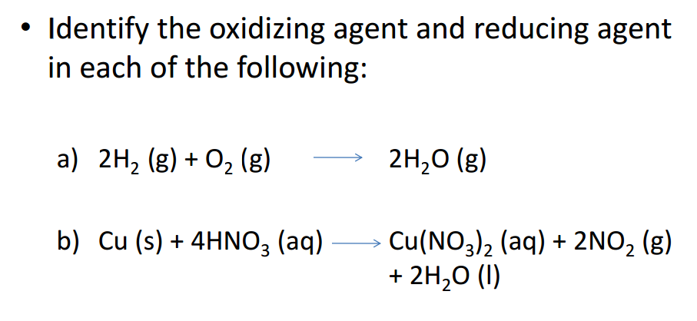
Example 2

Slide 21
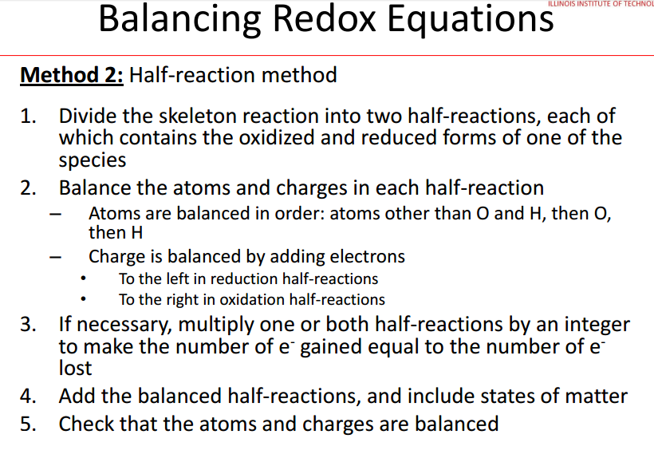

Slide 22
Guidelines for Balancing Redox Equations
Determine the oxidation states of each species.
2a)Write each half reaction and for each:
2b)Balance atoms that change oxidation state.
3)Determine number of electrons gained or lost
4)Balance charges by using H⁺ (in acidic solution) or OH⁻ (in basic solution).
5)Balance the rest of the atoms (H's and O's) using H₂O.
6)Balance the number of electrons transferred for each half reaction using the appropriate factor so that the electrons cancel.
7)Add the two half-reactions together and simplify if necessary.

Slide 23
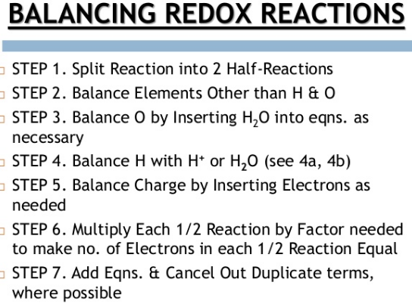

Slide 24
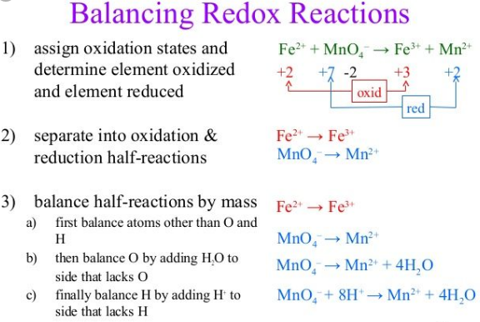

Slide 25
Balancing Redox Reactions
Now all charges and number of atoms balance. Finally, two terms you may run across in the future are
oxidizing agent (or oxidant) and a reducing agent (reductant).
An oxidizing agent causes oxidation and is reduced in the reaction.
A reducing agent causes the reduction in the redox reaction. The reducing agent is oxidized in the reaction.
In Example 4 above, MnO₄⁻ is the oxidizing agent and Cl⁻ is the reducing agent.

Slide 26
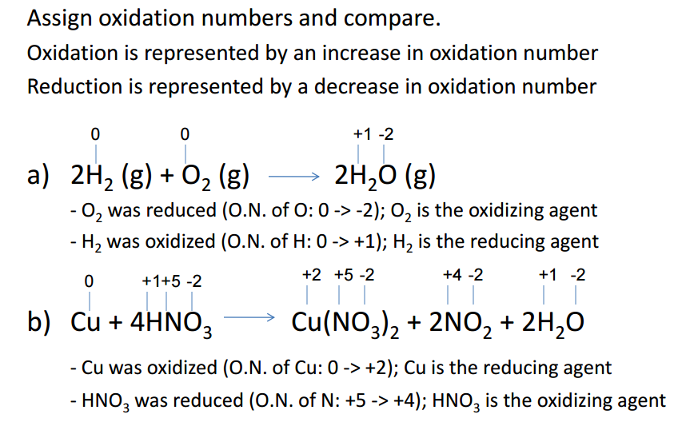
Solution to Example 2

Slide 27
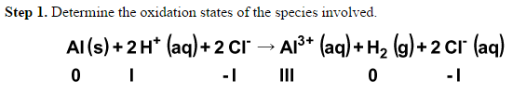
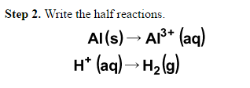
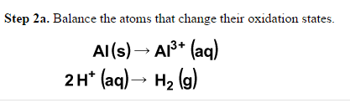
Example 3. Balance the following redox reaction.
The charges don't match yet so this is not a balanced equation. We can use each half-reaction to balance the charges. Notice that the Cl⁻ ions drop out, as they are spectator ions and do not participate in the actual redox reaction.

Slide 28
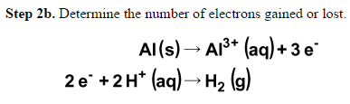
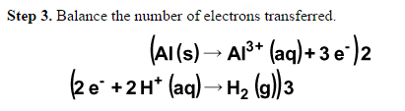
Aluminum changes from 0 to III, so three electrons are lost. For hydrogen, the case is a little different. Hydrogen is going from I to 0. This means that for each H⁺ ion that reacts, one electron is needed. Since there are two H⁺ ions that react, two electrons are needed.
Steps 2c and 2d are not needed in this case as the equations are balanced.

Slide 29
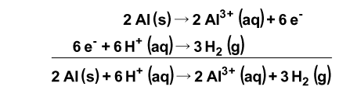
The common factor for the electrons transferred is 6, so the above multiplication is performed. Step 4. Now the charges and atoms are balanced. To verify this add all of the charges and atoms on each side. Both the charges and number of atoms must balance. Note that this reaction is not neutral. Remember that the spectator ions, Cl⁻, neutralize the solution.

Slide 30
Acidic Conditions
Acidic conditions usually implies a solution with an excess of H⁺ concentration, hence making the solution acidic.
The balancing starts by separating the reaction into half-reactions.
However, instead of immediately balancing the electrons, balance all the elements in the half-reactions that are not hydrogen and oxygen. Then, add H₂O molecules to balance any oxygen atoms.
Next, balance the hydrogen atoms by adding protons (H⁺). Now, balance the charge by adding electrons and scale the electrons (multiply by the lowest common multiple) so that they will cancel out when added together.
Finally, add the two half-reactions and cancel out common terms.

Slide 31


Example 4. Balance the following reaction, which occurs in acidic solution.
Step 1. Determine the oxidation states of the species involved. To determine the oxidation state of Mn in MnO₄⁻, apply Equation 1 (see Equation 1 above): x + 4(-2) = -1.
Step 2. Write the half reactions.

Slide 32
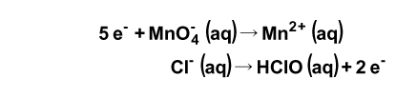

Step 2a. Mn and Cl are balanced.
Step 2b. Mn changes from VII to II, so five electrons are needed. Cl⁻ loses two electrons as it goes from I to -I.
Step 2c. The charges are not balanced on this example. Since this is in acidic solution, use H⁺ to balance these charges.

Slide 33
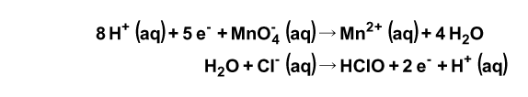
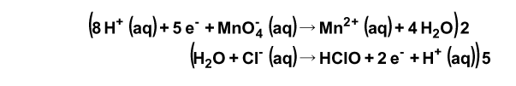
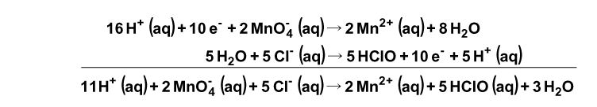
Remember that the electrons carry a negative charge and must be considered whenever balancing the charges. Verify that the charges are balanced on each side of the equation.
Step 2d. Now the oxygen and hydrogen atoms need to be balanced.
Step 3. Balance the number of electrons transferred.
Step 4. Write the net reaction.

Slide 34
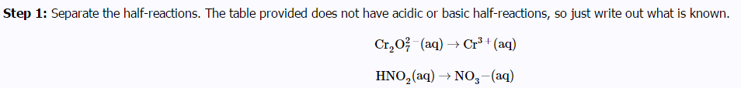
EXAMPLE 5: BALANCING IN A ACID SOLUTION

Slide 35


Solution
Step 1: Separate the half-reactions. The table provided does not have acidic or basic half-reactions, so just write out what is known.
Step 2: Balance elements other than O and H. In this example, only chromium needs to be balanced. This gives:

